Slide 1
Strategic E-Commerce Analysis: Unlocking Value & Operational Efficiency
Insights on Revenue Drivers, Customer Segmentation, and Satisfaction Opportunities for an English Clothing E-Commerce Company
[Laura Quintero, Andrés P. Salinas - apiscognos team] - [28/01/2026]

Slide 2
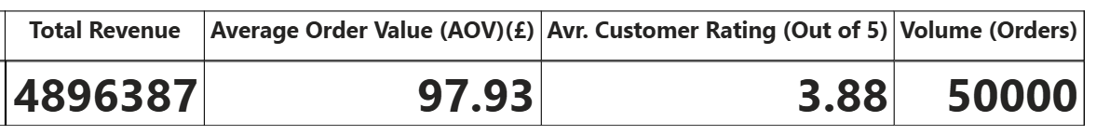
Executive Summary
The business has achieved a robust £4.89M in total revenue across 50,000 transactions, maintaining a healthy 3.9/5 satisfaction rating. While the operational engine is stable, there is a clear "Value Gap" in our subscription model that represents our largest immediate growth opportunity.
The business is well-established but currently operates on a transactional basis. To scale, we must pivot from "volume-chasing" to "value-deepening," specifically targeting the under-monetized subscriber segment.

Slide 3
Main Business Question
Which products, customers, and moments drive the highest revenue, AOV, average rating, and how to increase those?

Slide 4
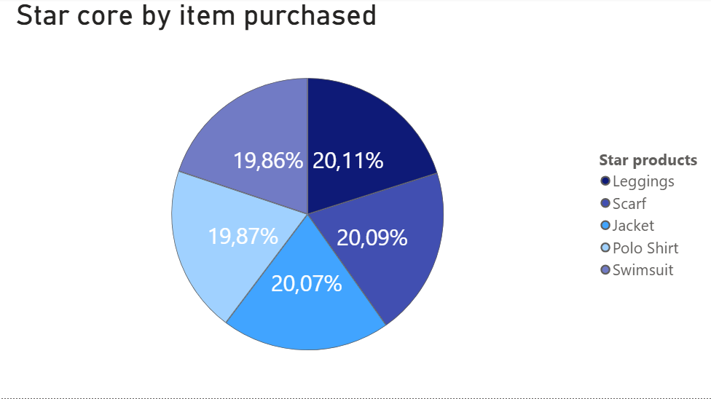
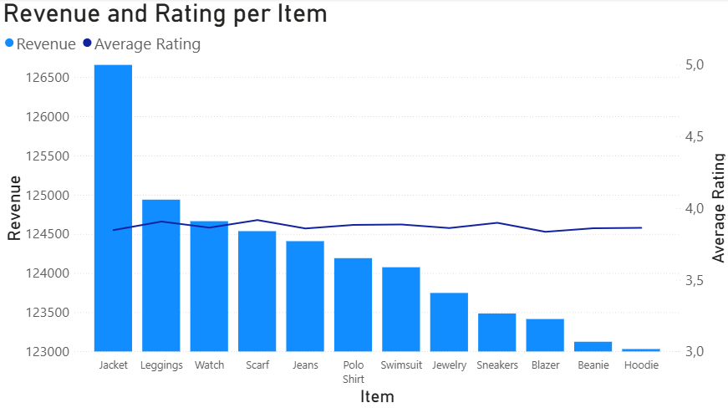
The Star Products
Star products show a balanced performance, indicating multiple high-value items within the portfolio. However, high-revenue products with lower customer ratings should be prioritized for improvement, as unresolved satisfaction issues may constrain long-term performance.

Slide 5
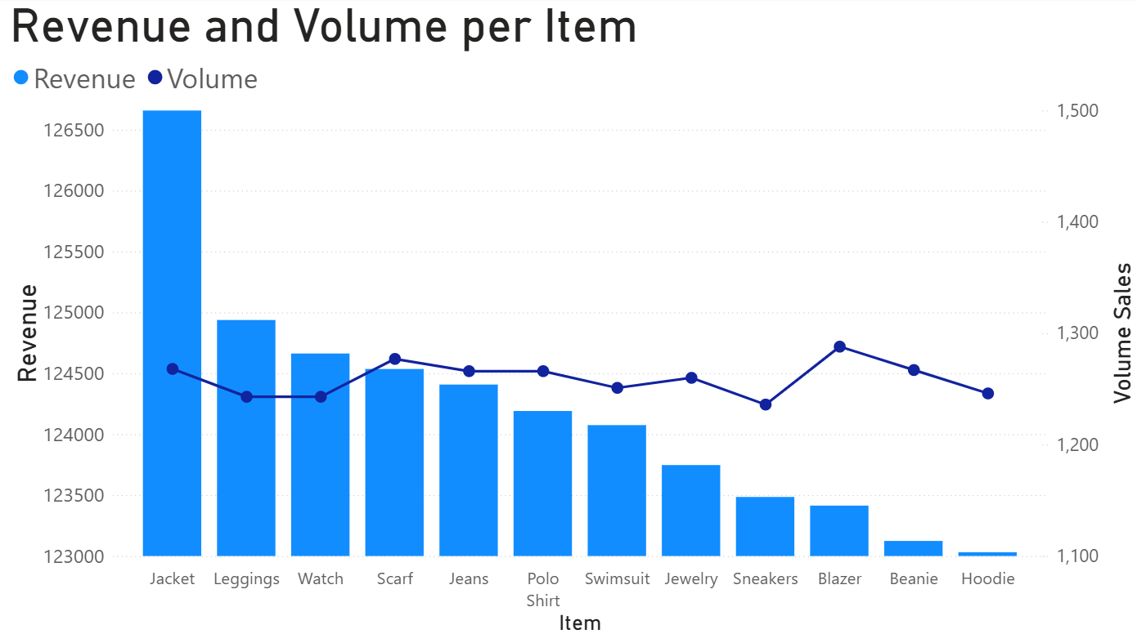
Maximize profitability by aligning pricing with demand
Closing the gap on high-volume products that aren't reaching their full profit potential through better pricing or bundling is priority. Meanwhile, The company should look to their high-revenue products as the blueprint for success to see what’s driving their strong performance.

Slide 6
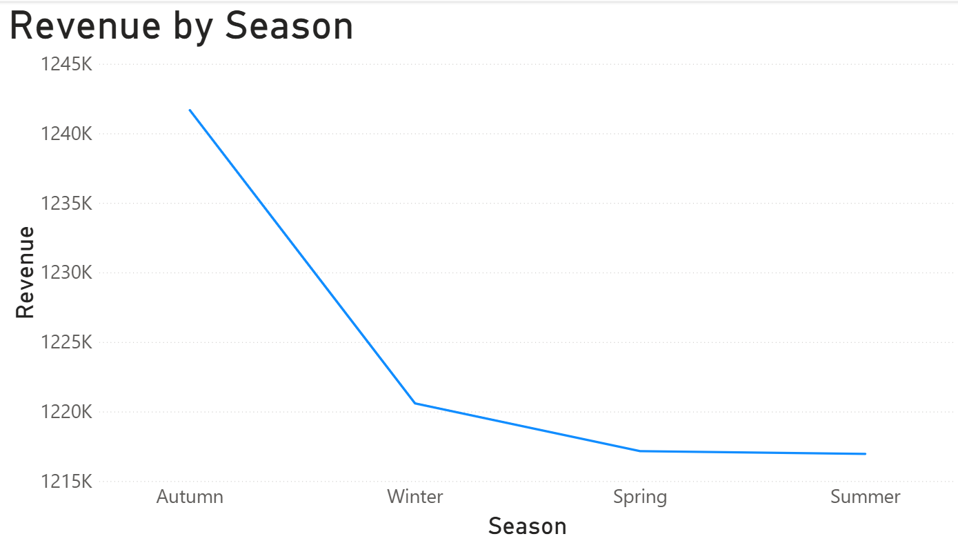
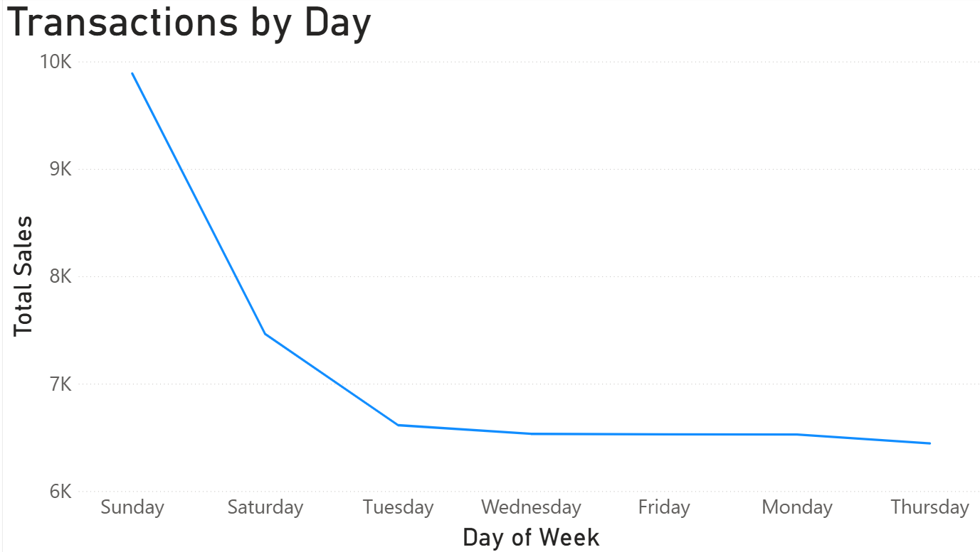
Autumn is the highest-revenue season, with most sales occurring on weekends
We recommend two actions: Increase staff during weekends to meet peak demand and develop exclusive products and strategies for low-performing seasons.

Slide 7
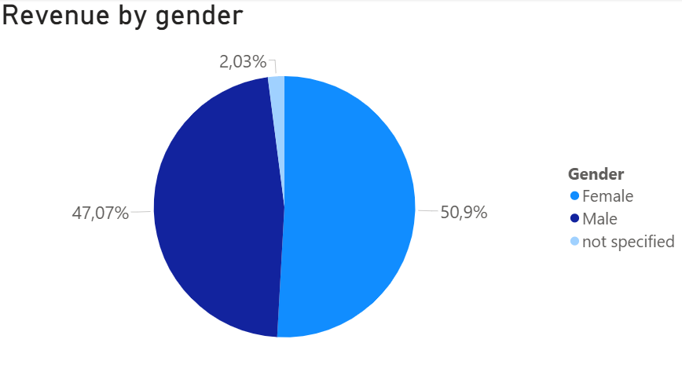
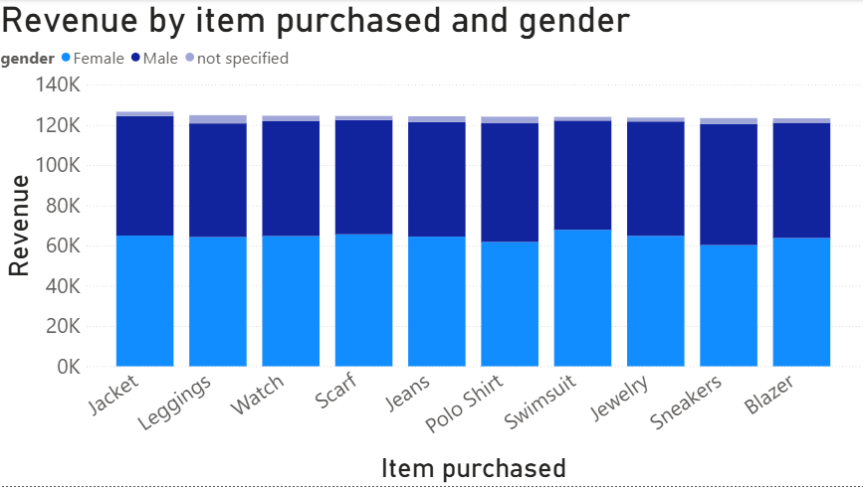
The customer base is nearly balanced
Revenue is distributed almost evenly across gender segments.
We recommend strengthening marketing efforts around the most preferred products by gender, particularly Swimsuits for female customers and Sneakers for male customers.

Slide 8
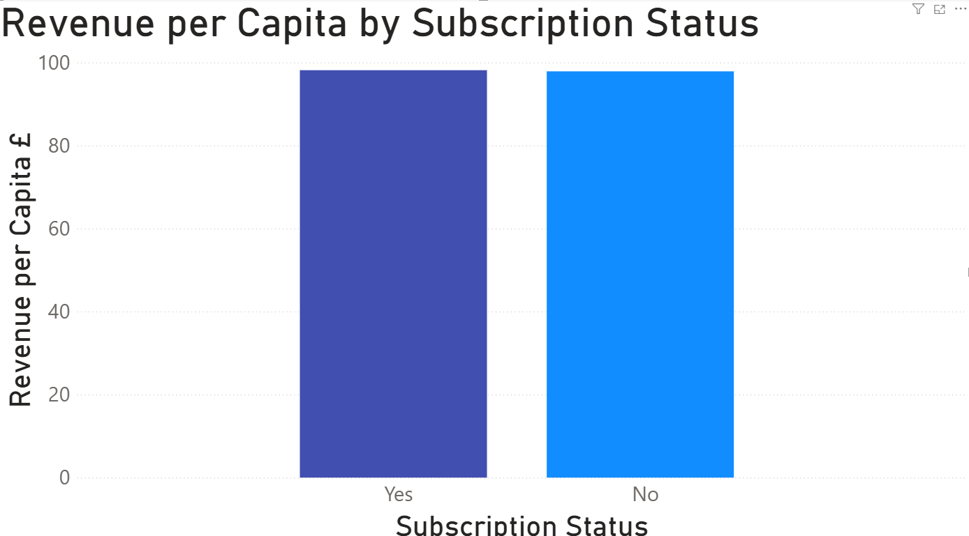
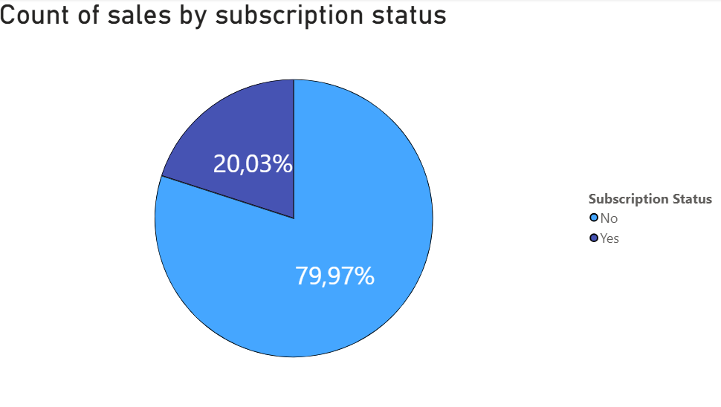
Subs & Non-Subs both spend ~£98 (per capita)
Despite being a premium minority (20%), the subscription program is under-optimized. Is needed to introduce exclusive bundles or perks to drive Subscriber AOV (Average Order Value) higher than non-subscribers.

Slide 9
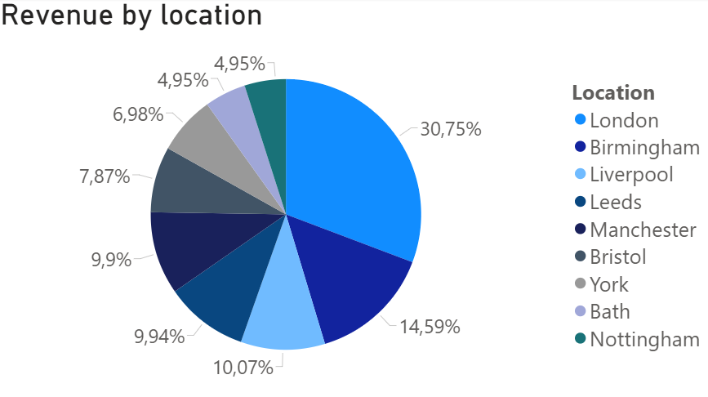
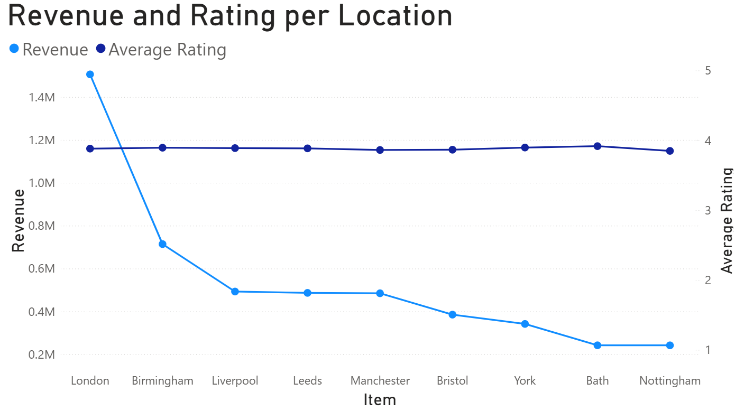
Geographic Performance
While sales scale naturally with city size, the consistent average ratings show the quality is being maintained across all markets. We recommend leverage this brand stability to aggressively expand in mid-sized cities where there is high growth potential but lower competition.

Slide 10
The Roadmap:
Short-Term: Match staffing to weekend peaks and launch subscriber perks to boost spend.
Mid-Term: Improve low-rated bestsellers and expand into high-growth mid-sized cities.
Long-Term: Shift focus to net profit margins and maximize long-term customer loyalty.

Slide 11
Technical Appendix
Methodology:
  Data cleaning in Python and Excel, Warehousing in SQL and Excel and Visualizations in Power BI.
Limitations:
  Synthetic dataset, It determined homogeneity of some data.
  While we started with a standard profit estimate, we know real-world margins vary by product. In our next step, we’ll dive into the specific numbers to give a more accurate picture of our true profitability.

